Slide 1


Project Management Principles and Practices
LECTURE # 7

Slide 2
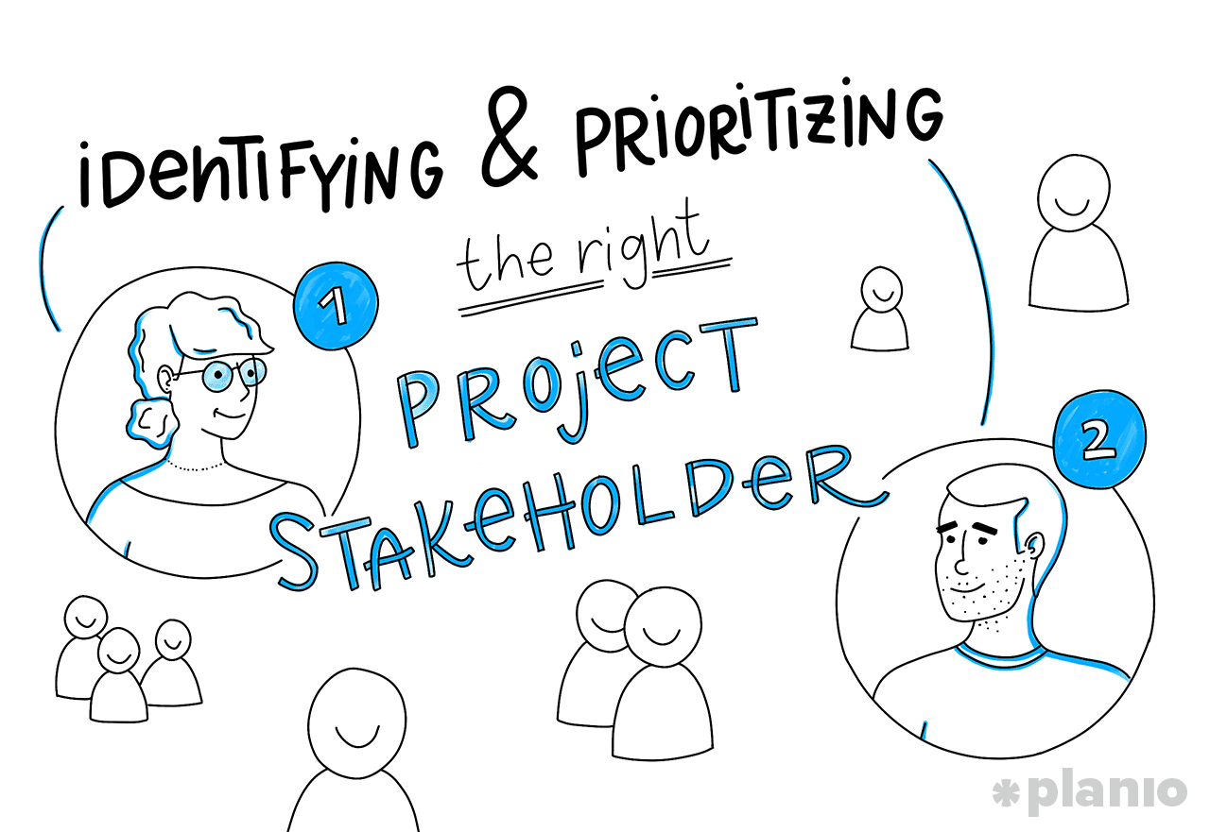
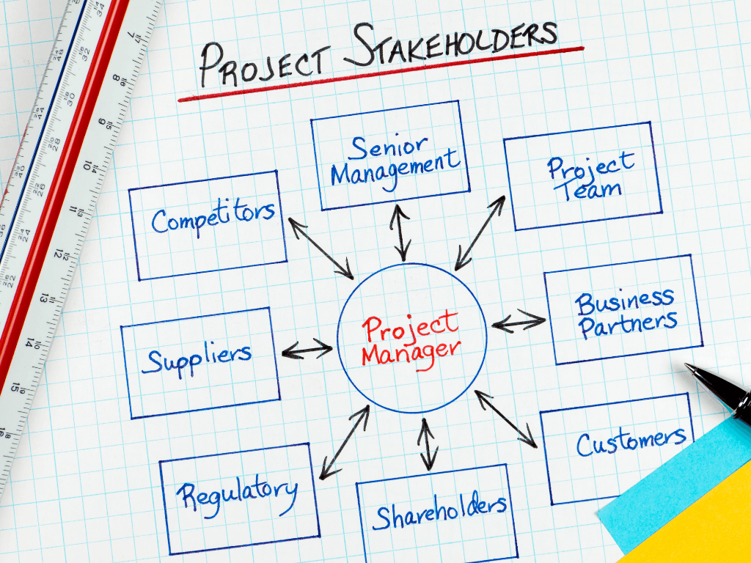
Project Stakeholders

Slide 3
STAKEHOLDERS
A stakeholder is anybody who has interest in your project.
According to the Project Management Institute, project stakeholders are defined as:
“Individuals and organizations who are actively involved in the project, or whose interests may be positively or negatively affected as a result of project execution or successful project completion.”
According to the PMBOK Guide, “A stakeholder is an individual, group, or organization who may affect, be affected by or perceive itself to be affected by a decision, activity, or outcome of a project.”

Slide 4
WHY STAKE HOLDERS ARE IMPORTANT?
1. Providing Expertise
Stakeholders are a wealth of knowledge about current processes, historical information, and industry insight. Many times these team members will have been at the company or on the project longer than the project manager or project team. It’s important to involve all key stakeholders when gathering and documenting requirements to avoid missing major deliverables of the project. Project managers, or others who are in charge of deliverables, may not be experts on every project. Key stakeholders can provide requirements or constraints based on information from their industry that will be important to have when understanding project constraints and risks.
2. Reducing and Uncovering Risk
The more you engage and involve stakeholders, the more you will reduce and uncover risks on your project. When discussing initial requirements, project needs, and constraints, stakeholders may bring up issues or concerns about meeting those things. Uncovering risks and then discussing a plan to mitigate them before issues arise will dramatically increase the success of your project. Involving knowledgeable stakeholders during this process will help.
3. Increasing Project Success
By gathering and reviewing project requirements with stakeholders, you will get their “buy-in,” which will in turn help increase project success. If you can’t meet stakeholders’ needs, due to conflicting needs or priorities, set expectations early in the project life cycle. This will help you manage the relationship throughout the project instead of there being surprises at the end. Stakeholders should always be aware of the project scope, key milestones, and when they will be expected to review any deliverables prior to final acceptance.
4. Granting Project Acceptance
The more regularly you engage and involve stakeholders from the start, the more likely you will have a positive project conclusion. By the end of the project, the team members should have already been aware of delivery expectations, risks, and how to mitigate the risks. They also should have reviewed draft deliverables along the way. This process should help avoid any surprises at the end of your project. The final acceptance is just their final stamp of approval during the project closure phase.

Slide 5
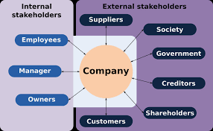
CAN YOU IDENTIFY ANY OTHER STAKEHOLDERS?

Slide 6
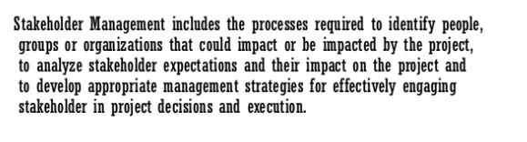
STAKEHOLDER MANAGEMENT

Slide 7
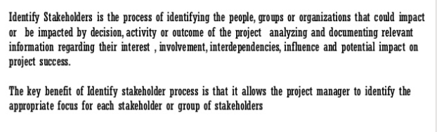
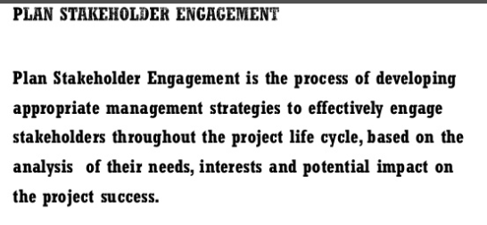
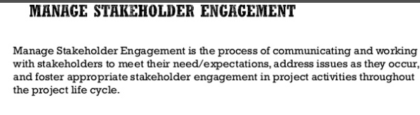
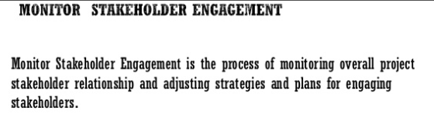
1- IDENTIFY STAKEHOLDER
2- PLAN STAKEHOLDER
ENGAGEMENT
4- MANAGE
STAKEHOLDER
ENGAGEMENT
3- MANAGE
STAKEHOLDER
ENGAGEMENT

Slide 8
Managing Project Stakeholders
Project Management Maxims:
  You can’t do it all and get it all done.
    Projects usually involve a vast web of relationships.
  Hands-on work is not the same as leading.
    More pressure and more involvement can reduce your effectiveness as a leader.
  What’s important to you likely isn’t as important to someone else.
    Different groups have different stakes (responsibilities, agendas, and priorities) in the outcome of a project.
  Remember: Project Management is tough, exciting, and rewarding—endeavor to persevere.
  To successfully complete a project, a manager needs not only to have a command of project estimation techniques, but to create positive relationship with stakeholders. Only when stakeholders’ expectations and agreed objectives are met, a project can be considered successful.
  Even successfully completed goals within budget frames can be considered a failure because a key stakeholder may not be satisfied.

Slide 9
IDENTIFY STAKEHOLDERS
Identify Stakeholders is the process of identify people, groups, or organizations that may impact or be impacted by your project. This process collects relevant information about your stakeholders and monitors their interests. Identifying and analyzing your stakeholders can minimize change resistors and lead to project success.

Slide 10
STAKEHOLDER ANALYSIS
This is part of the Identify Stakeholders process. But it is a substantial and important task. Big enough to merit its own stage in most methodologies
It’s a tool to identify :
Stakeholder position in organization
Role on the project
Stakes (Interest, Rights, Ownership, Knowledge, Contribution)
Expectations
Attitude (their level of support for the project)
Interest in information about the project

Slide 11
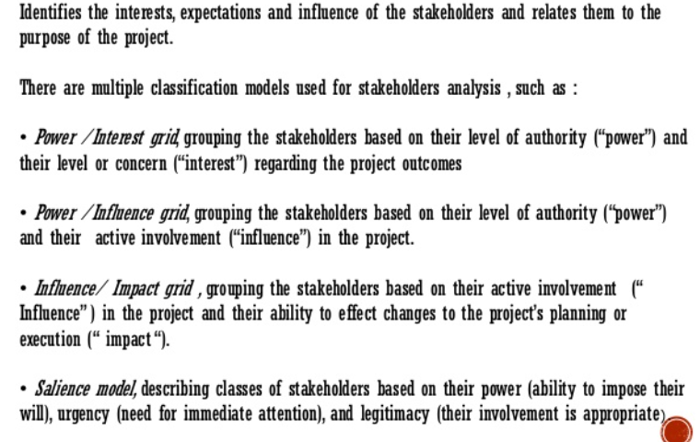
STAKEHOLDER ANALYSIS-Methodologies

Slide 12
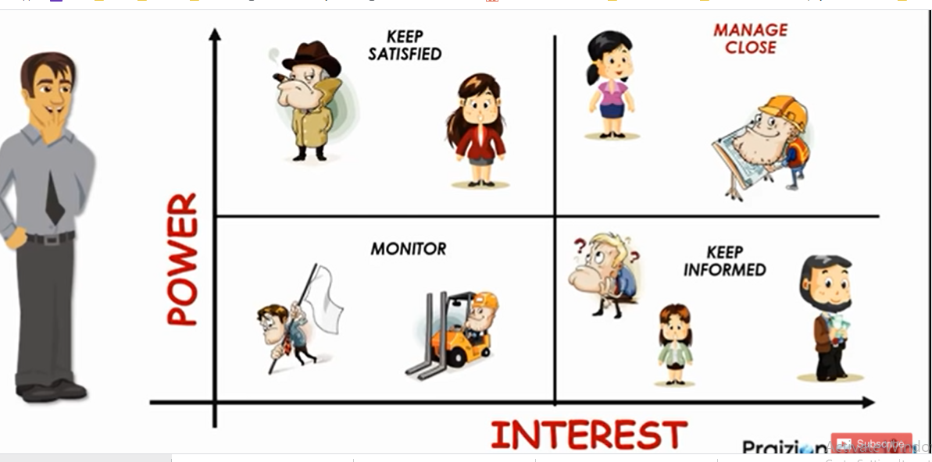
Stakeholder Analysis
Classification Models
Do not load them with detailed information from day to day. Simply keep them satisfied.
This group needs consultation, communication and engagement on a regular basis. It’s very important to deal with them closely.
Due to their high level of interest need to know about any changes or, say, progress of a project. So, keep them informed.
They are supposed to be monitored. Communicate with them, but without excessive details.

Slide 13
Scenario Answer
Keep Satisfied: The CEO (Alice) and the Major Investor (Eve) fall into this category. They have high power and are low interested in the project's success. Regular updates and assurance of positive progress are crucial to keeping them satisfied.
Monitor: The Legal Consultant (Frank) falls into this category. While he has low interest in the technical details, his expertise is essential for avoiding legal issues. Regular monitoring of his work is required to ensure legal compliance.
Manage Closely: The Project Manager (Bob), Lead Developer (Charlie), and Customer Representative (Grace) fall into this category. They have varying levels of power and are highly interested in the project's success. Close management is necessary to ensure their involvement and satisfaction with the project's progress.
Keep Informed: The Marketing Manager (David) falls into this category. He has moderate power and is highly interested in the project's success. Keeping him informed about the project's progress is essential to ensure that marketing strategies align with the project's timeline.

Slide 14
Salience Model
The stakeholder salience model was proposed by Ronald K. Mitchell, Bradley R. Agle and Donna J. Wood in 1997.
The term salience means “the quality of being particularly noticeable, important or prominent”, and so stakeholder salience means the importance you give to your stakeholders.
Stakeholder salience can be defined as the “degree to which managers give priority to competing stakeholders’ claims in their decision-making process”.
Depending on the presence or absence of one or several attributes, three classes of stakeholders may be distinguished.

Slide 15
Salience Model-
Stakeholders 3 Attributes
1- Power
Power is the authority or influence of the stakeholder on your project or its objectives.
Focus on stakeholders with high power. These stakeholders are fewer in number.
2- Legitimacy
Legitimacy is how genuinely involved a stakeholder is with your project. You should not spend your time on a stakeholder who doesn’t have a legitimate interest.
Pay attention to stakeholders with legitimate claims.
3- Urgency
Urgency is the degree to which stakeholder requirements call for immediate attention.

Slide 16
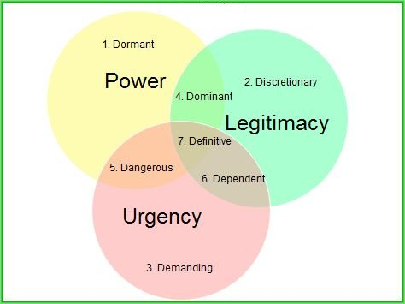
Salience Model- Low Priority
  Dormant – they are perceived as having power, but no legitimacy and no urgent claims and this results in a lack or low level of interactivity and involvement.
  Eg: Top Management
  (Monitor)
  Discretionary – they are perceived with legitimacy, but without power and urgent claims. Some managers choose, however, to closely manage them especially if the acquisition of a type of power is possible. They may be courted for alliances by Dangerous stakeholders because the latter have no “legitimacy”. Monitor ( Min Effort)
  Eg: NGO, Charitable Organizations
  Demanding – they are perceived as having urgent claims and no power and no legitimacy. They are synonymous to the mosquito buzz. :)
  Eg: Public Place- Neighbourhood
  Keep informed

Slide 17
Salience Model-
Moderate Priority
Dominant – one of the two types of stakeholders perceived as having both power, and legitimacy. Unlike the “definitive” type, dominants have no urgent claims. Such groups or individuals can be found often in mature companies
EG:constructing a building projct- local authorities
Sol:Keep Informed!
  Dangerous – they are indeed dangerous. They are perceived as having power and urgent claims. They have no legitimacy. And then they tend to use, first of all, coercive power.
  They can even become aggressive.
  Eg: remote area of a third world country, and in this case, a group of local terrorists
  SOL: Keep Satisfied!
  Dependent – they are perceived as having legitimacy and urgency, but no power. They are pursued for coalitions by the Dangerous stakeholders until the latter manage to also acquire “legitimacy”. “Dependants”, however, seek alliances with the “dominants” to use their power to enforce their own urgent claims.
  Eg; construction work in a public place, local residents
  Sol: Manage closely!

Slide 18
Salience Model-
Highest Priority
Definitive stakeholders having all 3 attributes, treated with high priority
Eg: top management of your organization
Sol: Manage Closely!

Slide 19
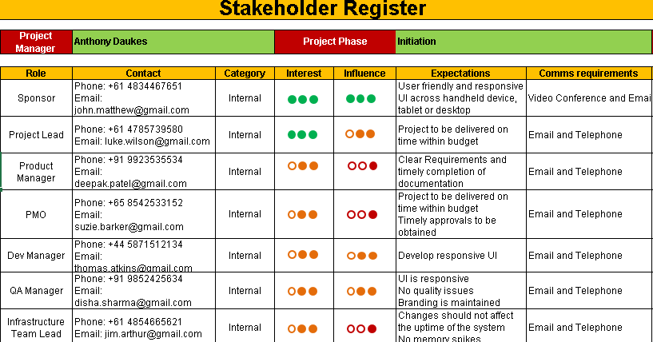
Stakeholder- Register

Slide 20
PLAN STAKEHOLDER
Plan Stakeholder Engagement is the process of developing strategies to increase stakeholder interest and engagement on your project. The goal is to increase project supporters and minimize resistors throughout the entire project lifecycle.
There are 5 levels of stakeholder engagement:
Unaware
Resistant
Neutral
Supportive
Leading
Stakeholder engagement assessment matrix is used to map a stakeholder’s current engagement level and his/her desired engagement level.

Slide 21
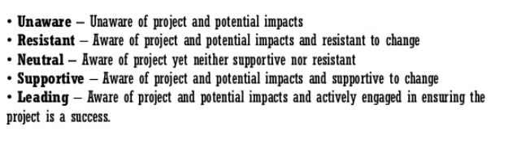
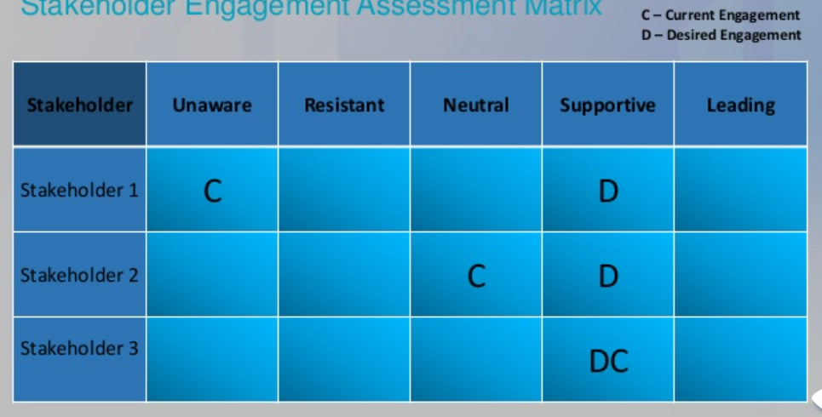
STAKEHOLDER MATRIX

Slide 22
Manage Stakeholder Engagement
Manage Stakeholder Engagement is the process of communicating and working with stakeholders to meet their expectations. This process involves engagement stakeholders, addressing their concerns, and clarifying issues.
When the stakeholders feel their concerns have been heard and addressed, their support for the project will increase.
The stakeholders’ influence on the project is highest during initiation and gets progressively lower as the project progresses.
To be successful on this process, you, the project manager, need to have strong interpersonal skills, such as conflict resolution and active listening.

Slide 23
Monitor Stakeholder Engagement
Monitor Stakeholder Engagement is the process of monitoring overall project stakeholder relationships and adjustment strategies for engagement accordingly.

